Slide 1

Movie Studio Analysis
Microsoft Movie Studio Feasibility Study Using EDA
Presented by: Vivian King’asia
Last updated: 21st May, 2020

Slide 2
AGENDA
Introduction
Questions to be answered
Solution Process
Data Analysis
Key Findings
Recommendations
Conclusion

Slide 3
Introduction
Microsoft wants to open a movie studio.
There is inadequate knowledge about the movie industry and factors influencing the success of movie studios.
An exploratory data analysis was conducted in this study.
Different genres of movies were explored.
Top movie studios in the industry were explored.
Relationships between various variables were explored.
Recommendations have been provided at the end of analysis.

Slide 4
Questions to be Answered
What are the biggest competitors in the industry?
What are the most profitable genres to invest in?
Does ratings affect box office earnings and profitability?
Are there differences in preferences in genres domestically and internationally?
Does movie runtime affect box office earnings and profitability?
What is the relationship between production budget and earnings as well as profitability?
What has been the performance of the industry over the years in terms of profit?

Slide 5
Solution Process
Four datasets were used.
The bom movie gross dataset contained the title of movie, name of studio, year published, domestic gross earnings and foreign gross earnings.
The title.basics dataset contained movie titles, genres, years published and runtime in minutes.
The title.ratings dataset contained the average rating and number of votes casted for movies.
The tn.movie_budgets dataset contained the release date of the movie, title, production budget, domestic gross earnings and worldwide gross earnings.
The four datasets were merged after preliminary cleaning.

Slide 6
Data Analysis
Unnecessary columns like extra title column, extra year columns as well as duplicated columns were dropped from the data frame.
All datasets were merged using an inner join to get values of shared columns and reduce null values in the final dataset.
To achieve uniformity, some columns were renamed.
Duplicated rows were also removed from the data frame after merging all datasets.
Production budget, domestic gross and worldwide gross columns were converted to numerical columns.
Punctuations were also removed to facilitate conversion to numerical columns for the above named columns.
A box plot was used to determine outliers and missing values in the data frame.
Missing values in categorical column were filled with values from the following row.
Missing values in numerical column were filled with median value for the column.
A total gross earnings column and profit columns was calculated and included.

Slide 7
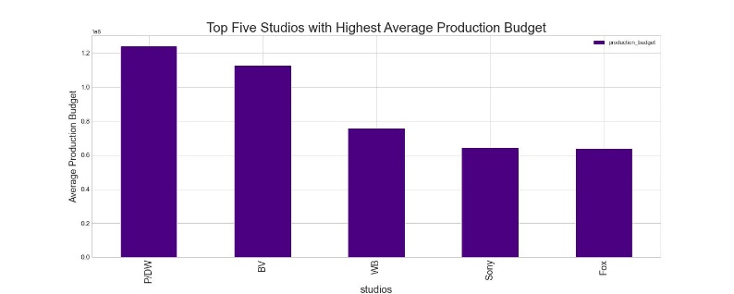
Key findings Studios: Comparing budgets and profit for Top studios

Slide 8
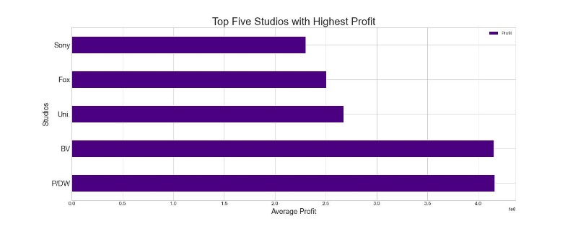
Key findings Studios: Comparing budgets and profit for Top studios

Slide 9
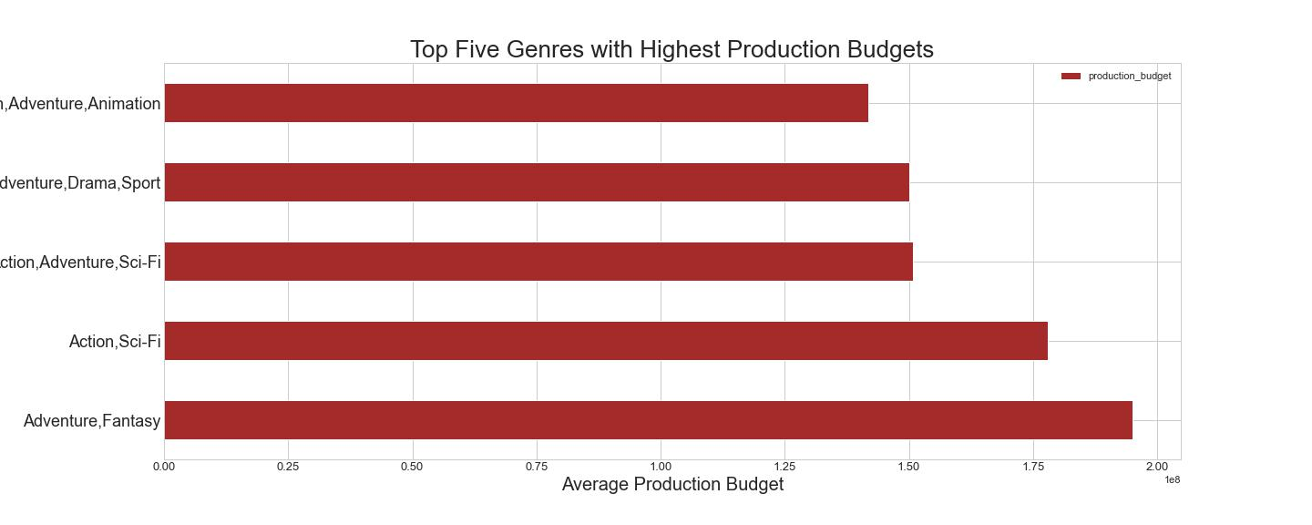
Key Findings Genres

Slide 10
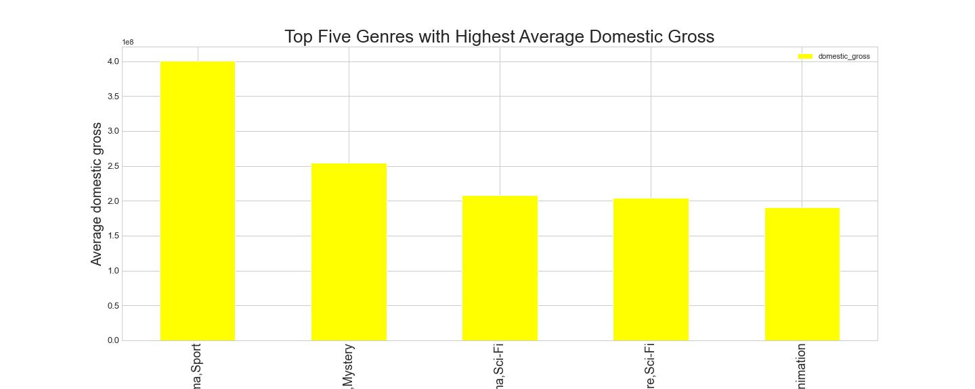
Key Findings Genres

Slide 11
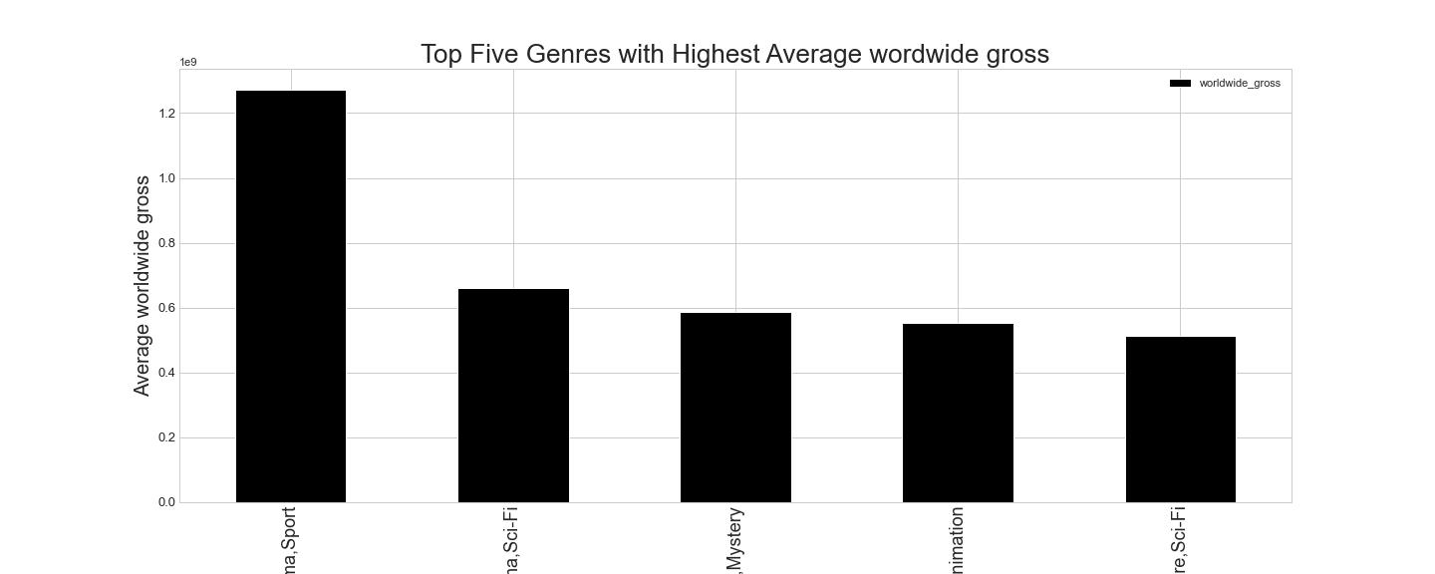
Key Findings Genres

Slide 12
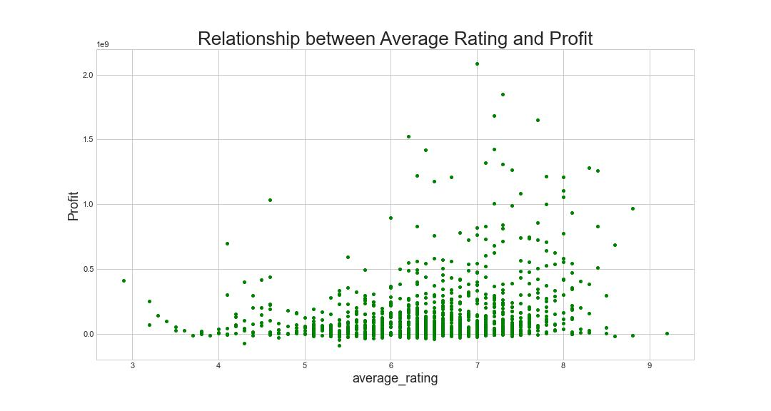
Key Findings Relationship between ratings and profit: No correlation

Slide 13
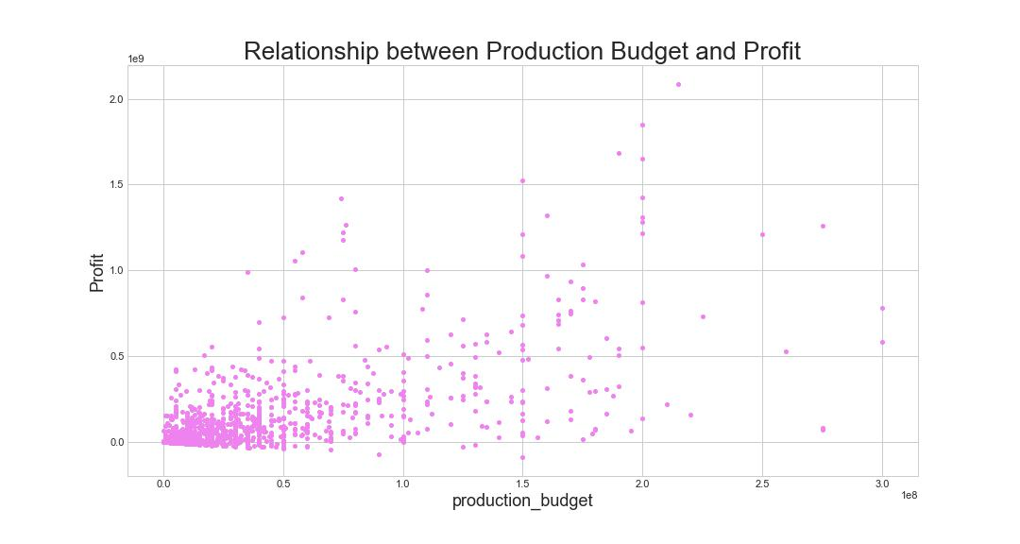
Key Findings Relationship between budget and Profit: weak to no correlation

Slide 14
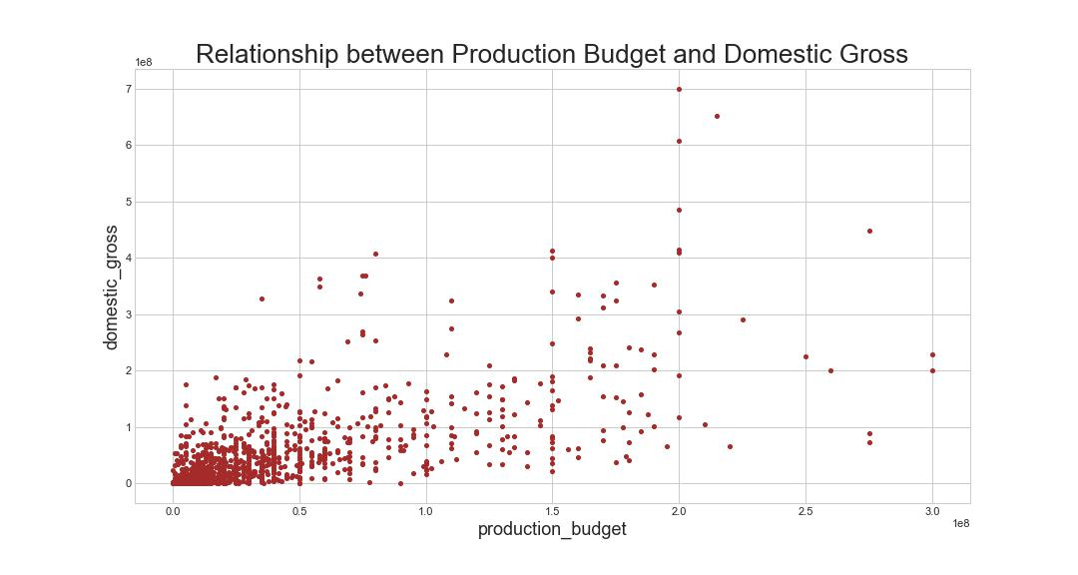
Key Findings Relationship between budget and domestic gross: weak positive correlation

Slide 15
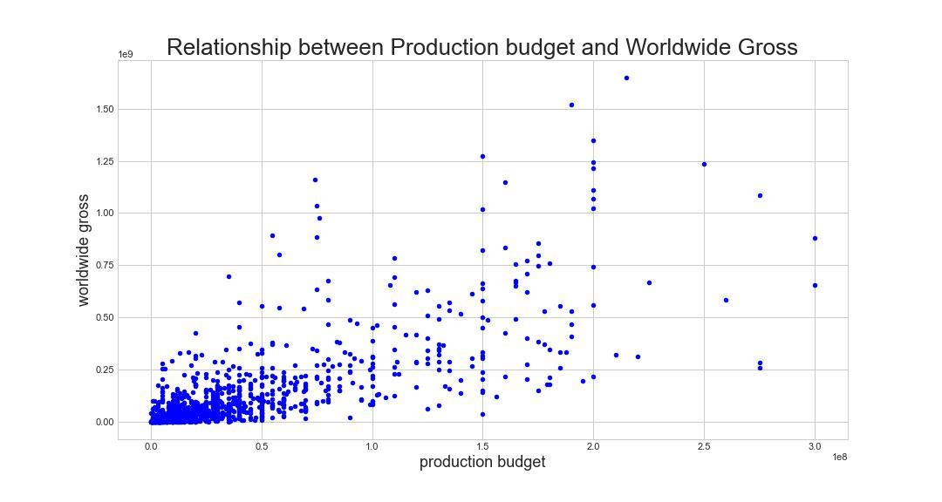
Key Findings Relationship between budget and worldwide gross: weak positive correlation

Slide 16
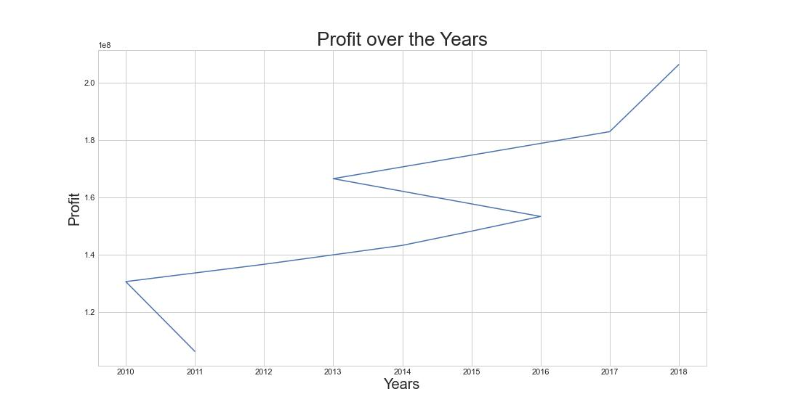
Key Findings The trajectory of profit from movies over the years

Slide 17
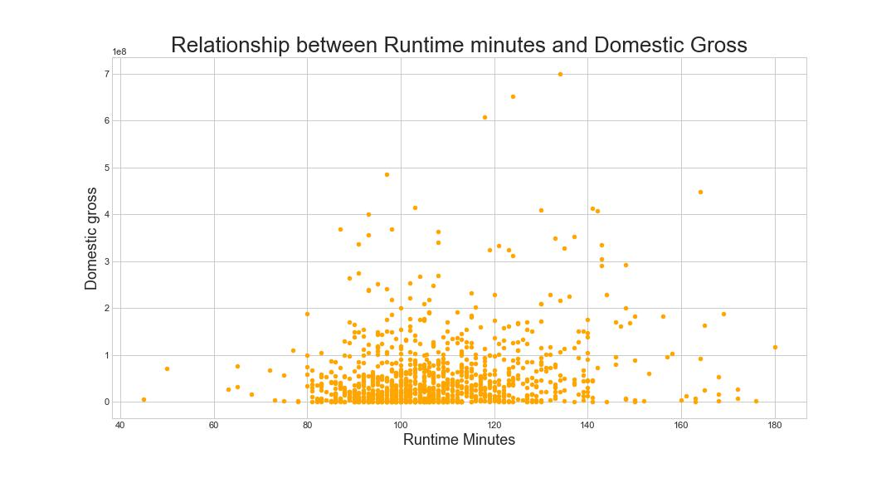
Key Findings The relationship between runtime and domestic gross: no correlation

Slide 18
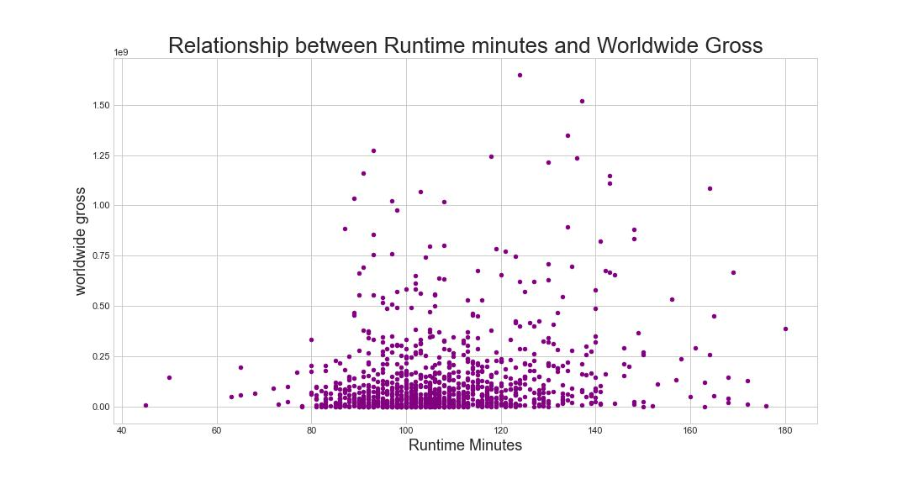
Key Findings The relationship between runtime and worldwide gross: no correlation

Slide 19
Recommendations
The movie industry has experienced increased profitability over the years.
Opening a movie studio would likely be profitable for Microsoft.
Popularity of movie genres varies domestically and internationally, Microsoft needs to invest wisely and differently in genres across domestic and international markets.
Microsoft should not focus on increasing budget as it is not strongly correlated to overall profit. It should pick popular genres that do not require large budgets to make huge profits.

Slide 20
Conclusion
Ratings and runtime minutes are not correlated with gross earnings or profit.
Top competitors for Microsoft would be P/DW, BV, Sony, Fox and Universal Studios.
Top profitable genres to produce are adventure, drama, sport and comedy, mystery and adventure, drama and sci-fi.
The production budget has a very low to no correlation to profits.
Weak correlation between production budget and domestic and worldwide gross box office earnings.
Microsoft has the potential of making a profit and competing in this industry if it invests in the right genres.

